Slide 1
S&I Framework
Public Health Reporting –
S&I Framework CEDD Overview
Saturday, January 05, 2013

Slide 2
Why is a CEDD needed?
Helps define the understanding of data exchanged across S&I Framework initiatives.
Provides a view of the clinical and technical requirements of data
Go from requirements to clinical need to technical representation to implementation
Supports implementation guidance development and requirements traceability
Advances interoperability within the S&I Framework by serving as a common foundation for standards
Draws from underlying information models within standards to help in the identification of gaps and enhancements needed to provide tangible value

Slide 3
S&I CEDD Development to Date
Used as a fundamental building block to move from clinical need to technical representation to implementation
Draw from past and current work in S&I and FHA
Provide a path to harmonize clinical concepts with public health understanding and know-how
Foundational tools and presentations are available and education will be part of the approach

Slide 4
S&I Framework CEDD - Evolution
Focus on keeping as lightweight as possible because maintenance ultimately will fall to the SDO’s whose standards we are adopting.
CIM –started as a clinical information modeling effort, then shifted to
CEDD – became a more clinically focused data dictionary
CEDD to Consolidated CDA – then focused on mapping
The “ToC CEDD" is for all practical purposes the HL7 balloted specification and is fully aligned to the Consolidated CDA.
By default, the S&I CEDD will have fewer data elements available to Transitions of Care for initial review than what can be described by CDA.

Slide 5
Example of CEDD Objects – Defining Clinical Need
A/I Attributes | Veracity of the data based on source and details available about index reaction(e.g. older patient has been told that had a Rx as a child vs. clinician has healthcare professional documentation of an anaphylactic episode) | CD (Concept Descriptor) | Either the Allergy/Adverse Event Medication Drug Class Value Set, or the Allergy/Adverse Event Medication Clinical Drug Name Value Set | Older patient has been told that had a rxn as a child vs. clinician has healthcare professional documentation of an anaphylactic episode
Environmental Allergens | A list of associated environment allergens for the medication includes seasonal allergens. | CD (Concept Descriptor) |  | Examples of environmental allergens include latex, pollen, animal dander, etc...
Food Allergens | A list of associated food allergens for the medication | CD (Concept Descriptor) |  | Examples of food allergens include shellfish, eggs, peanuts, etc.
Reaction Date | Date when this particular Intolerance Condition or Allergy first manifested itself or was confirmed via testing if it had not yet manifested itself. | Date/Time

Slide 6
Example of CEDD Objects – Alignment from Clinical to Technical
CEDD Object Name | CDA Template ID | CDA Section ID | CDA Entry ID
Active Medication List | 2.16.840.1.113883.10.20.22.2.1.1 2.16.840.1.113883.10.20.22.2.1 2.16.840.1.113883.10.20.22.2.38 | 4.28 Medications | 5.14 Medication Activity 5.16 Medication Information 5.12 Indication 5.13 Instructions 5.17 Medication Supply Order 5.19 Precondition for Substance Administration 5.9 Drug Vehicle
Active Problem List | 2.16.840.1.113883.10.20.22.2.7 | 4.40 Problem List | 5.3 Allergy Problem Act 5.5 Condition 5.6 Condition Entry

Slide 7
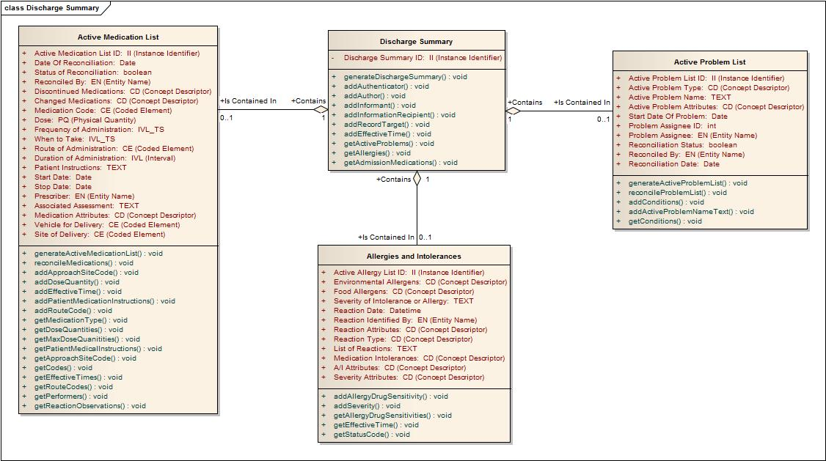
Example CEDD Outputs – Supporting UML Models

Slide 8
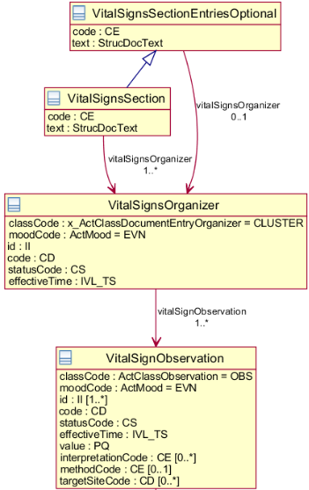
Example CEDD Objects – Implementation Guidance

Slide 9
CEDD Workgroup
Chairs – Holly Miller, MedAllies, Russell Leftwich, State of Tennessee, and John Donnelly, IHE
Combination of clinical and technical expertise
The S&I Framework CEDD Workgroup is the main volunteer body responsible for maintaining and improving the CEDD
The CEDD Workgroup serves primarily as a control board, not an exploratory/design activity
The workgroup meets on a monthly basis to discuss changes and improvements to the S&I Framework CEDD

Slide 10
CEDD Supporting Blocks
CEDD Tooling
UML Models – some supporting UML models may be developed for implementation guidance, but also coordinate with current efforts like FHIM, CIMI and other information modeling efforts.
ERD Models – used to support implementation of the data dictionary as a data source or to map to existing data sources
Value Set Index – similar structure to HITSP C80
CEDD Recommendation Forms – to propose changes and additions

Slide 11
CEDD Challenges
How is it actualized and accessed?
Avoiding replication of effort
Avoiding “doing too much”
Focus on what we do well
Clarity required to map from the functional names to the actual data element names,
Example – how to support the qualifier "ACTIVE" for accurate interpretation when applied to "medications list" or "conditions".

Slide 12
What the CEDD cannot do
Not intended to replicate current information modeling efforts
Not a true “clinical information model”
Does not fix or mitigate existing gaps in standards or underlying information models
Ultimately the SDO maintains and improves their standards
Not intended to be a super-model of data
Focused on S&I Framework initiatives and their interoperability requirements

Slide 13
Building Block - Domain Analysis
For Public Health, start with 1 domain and work forward – promote reuse, understanding and momentum
Transitions of Care tried to draw from other approaches already in use or in motion (HL7 Domain Analysis Models, CIMI, etc…) and also looked to use FHIM and FTRM as well
Defined specifics on information exchange requirements
Used Consolidated CDA as a starting point to align clinical need to technical representation
Included identification of gaps for eventual submission to HL7, IHE, and other SDO’s

Slide 14
Building Block - Public Health CEDD “Blueprint”
The nature of the Public Health CEDD would be defined like Transitions of Care
Identify and design to create reusable components representing public health information
Promote reuse of public health standardized data elements in other contexts
Serves as a temporary blueprint to eventually promote reuse through the S&I Framework CEDD
Develop a temporary mechanism that eventually populates the larger S&I Framework CEDD and also can be implemented in other formats and mechanisms

Slide 15
Building Blocks – Public Health Data Element Reuse
Harmonization of public health data elements
Draw from existing S&I CEDD work
Establish Public Health CEDD “temporary” blueprint to represent each of the 5 domains
Leverage FHIM and FHTM to finalize UML models
Harmonization of vocabularies
Identify where and what freely consumable and identifiable value sets are needed
Reuse value sets from S&I Framework where appropriate
Leverage FHIM and FHTM to model

